Slide 1
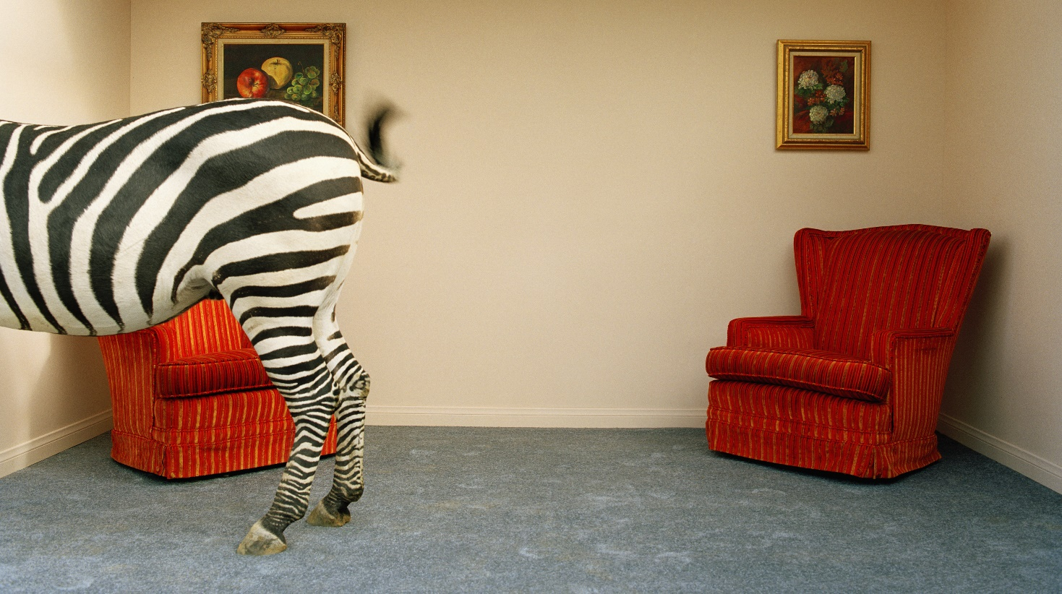



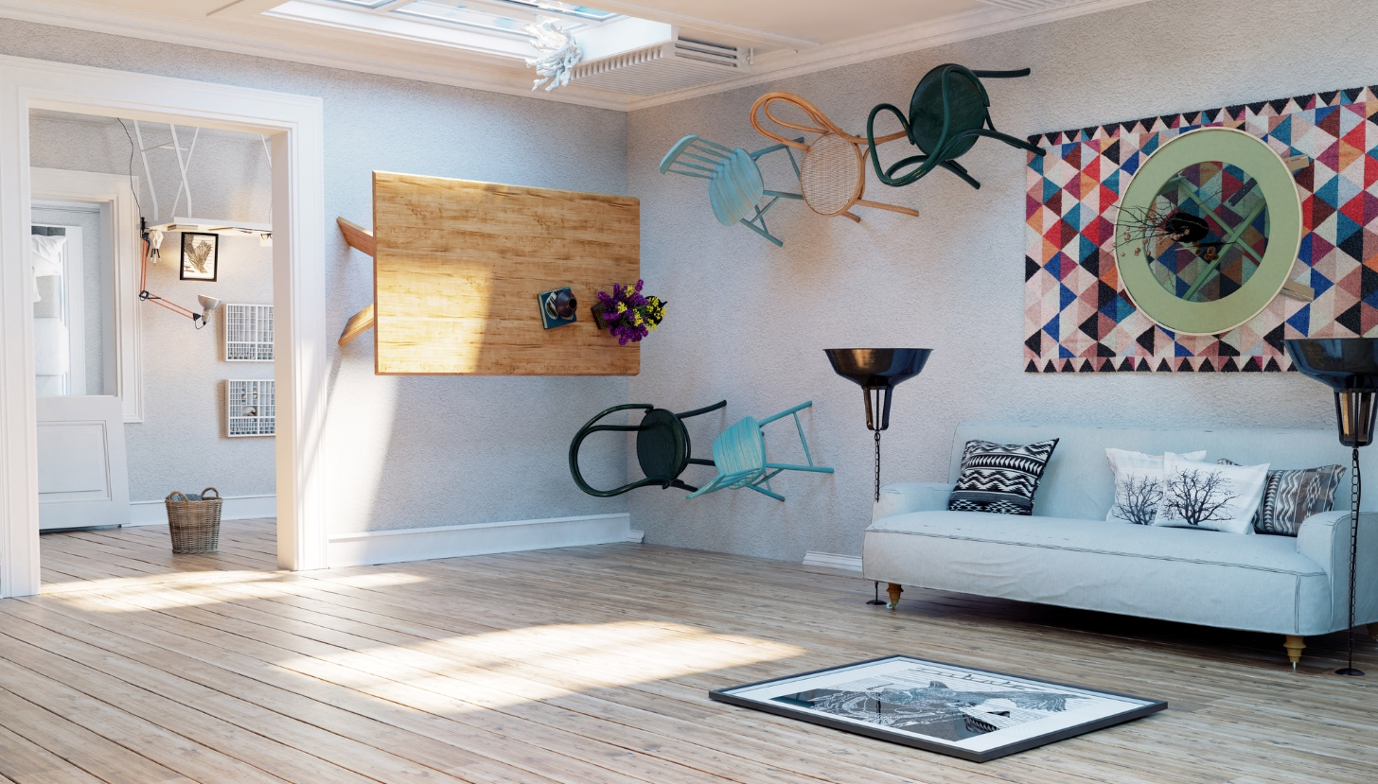
Comp Sys Assignment 2
Project Title: Smart Home Office Automation
Student# : 20091380
Name : Seamus McCarthy

Slide 2

Whimsical Room 4
SHOM : Smart Home Office Automation
SHOM is a Python web application designed to allow remote workers to maximise their control of the home office environment, highlight any problematic patterns in their working hours and alleviate some issues associated with working from home. The system will allow the user to :
Log in automatically via Bluetooth identification
Measure temperature and humidity via a Sense Hat
Control their office environment via TP-Link Smart Plugs & IFTTT
Utilise a “Do Not Disturb” function via a TP-Link Smart Bulb & IFTTT
Record their working hours to user-specific Thingspeak channels
Log user-specific break times & durations to a Firebase database
Concept

Slide 3
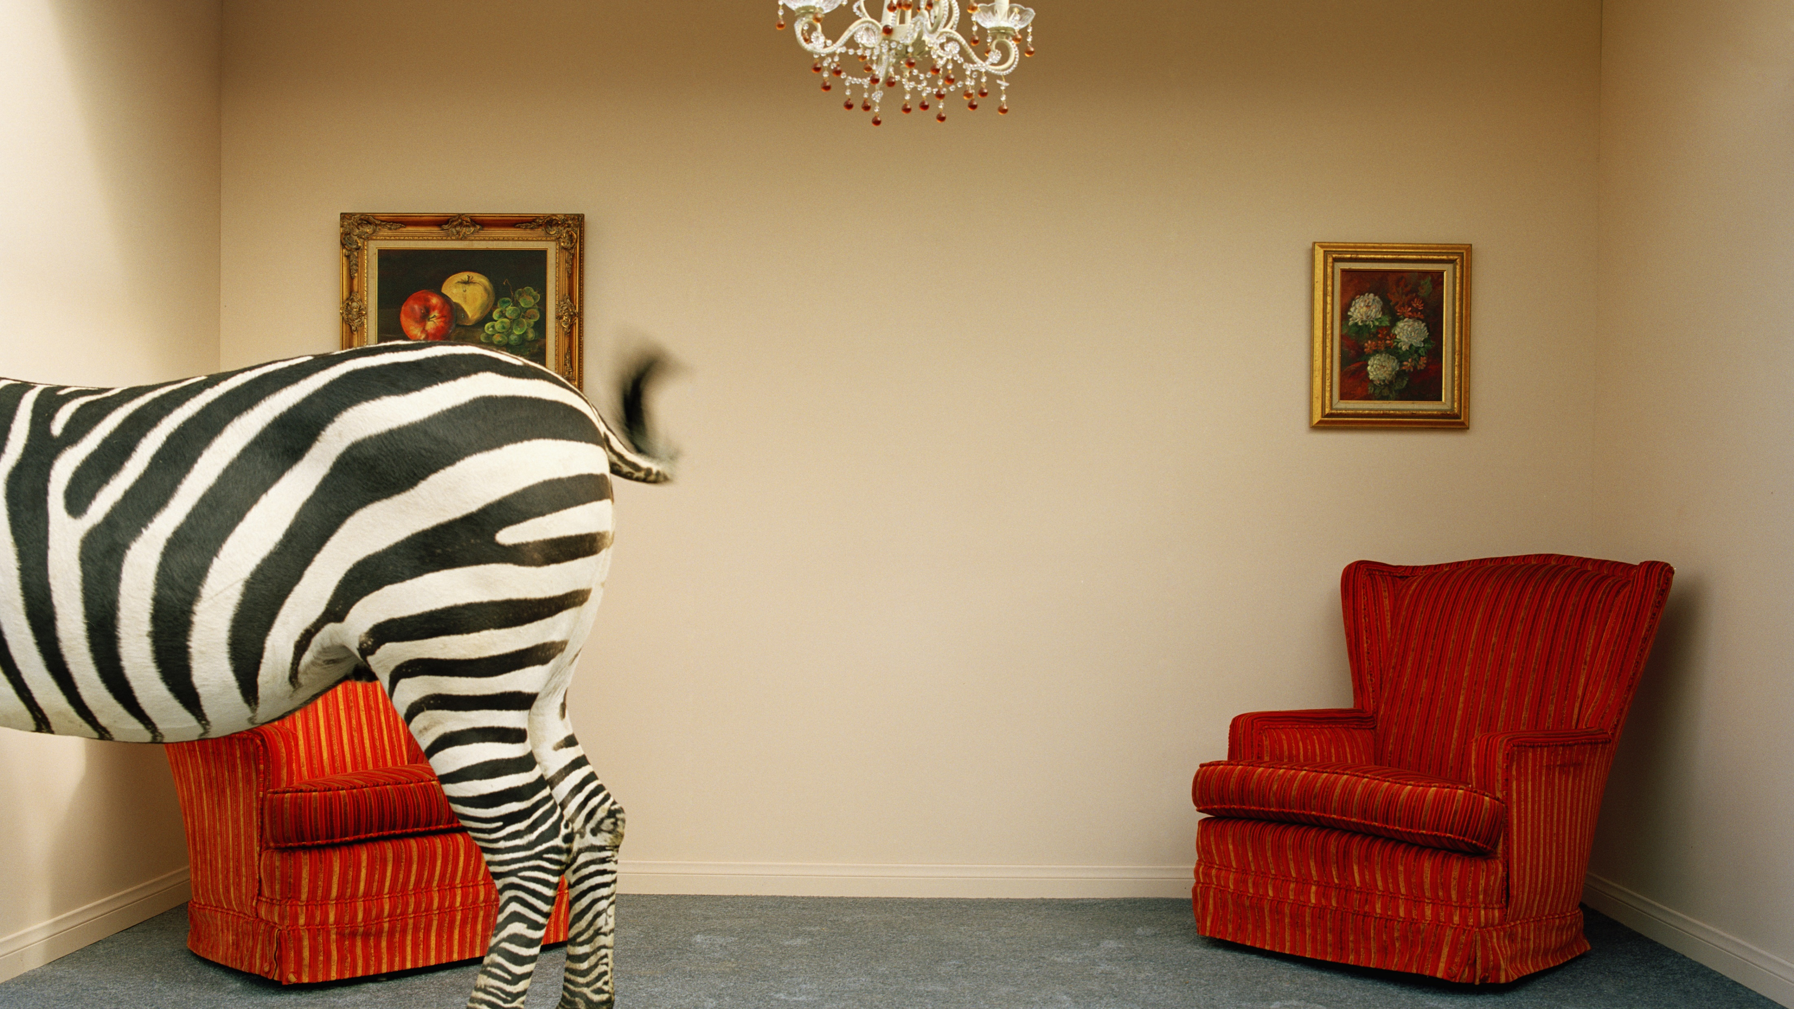
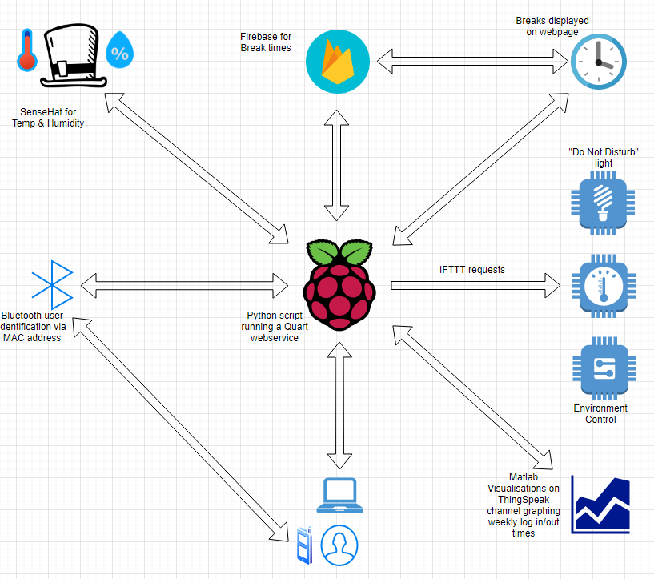
Whimsical Room 1
Project Components

Slide 4
Application Details
Script setup
When script is first executed, Bluetooth is used to identify any nearby known MAC addresses.
Once a known device is found, this identifies the user and associated details such as the API keys & public URLs for the user’s Thingspeak channel.
A dictionary is loaded for known smart devices and another is populated from existing Firebase break data.
The web service is then launched passing this information into the page.
Web service
A Quart web service that utilizes Jinja templating for displaying multiple records from the devices dictionary and from the break time data passed in from Firebase.
Various routes are used for controlling the smart devices and stopping/starting break times and the working day log on/off times.
The page will auto-refresh every 30 seconds to ensure that the sensor readings are constantly updated.
Technologies and packages used
Bluetooth user identification uses the PyBluez package.
A SenseHat will be used to record the temperature and humidity on each page request/refresh.
IFTTT requests will be used to toggle the state of the devices.
Firebase will be used to record the break times.
Thingspeak channels will record the day values (log on/off times, total break durations).
MATLAB visualisations are used to graph the results and these will be displayed on the webpage.

Slide 5
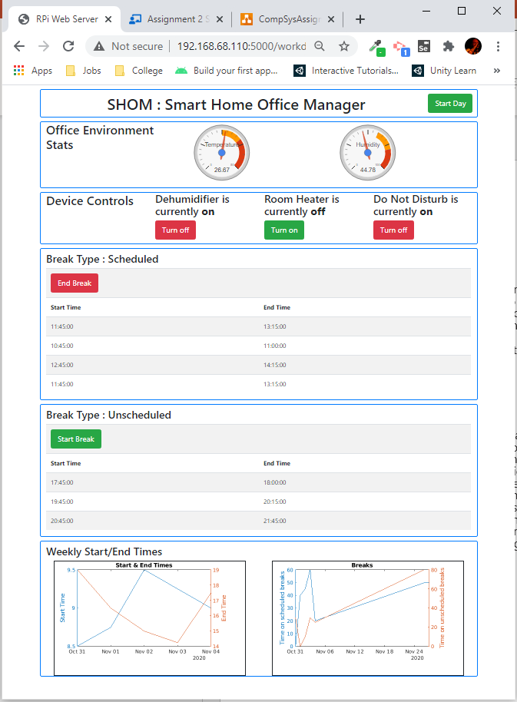
Other considerations & prototype
Python-kasa
Initially, I had wanted to use Python-kasa to control the TP-Link devices. This was prototyped and found to work as I wanted. However, a firmware update in early November blocked the port that is required for the python-kasa package to work. Though a fix is being worked on, I have switched the solution to use IFTTT requests to toggle the device state.
Cloud4RPi
Cloud4Rpi was looked at briefly as a possible dashboard replacement but didn’t appear to have an option for displaying table data such as the break start/end times. I looked at using it only for sensor data and devices switches so that it could be embedded into my webpage as an iframe but the public view of the dashboard is read-only so I cannot utilize this for switches and the private view has an unsightly ‘Register/Sign-up’ prompt. So for now, I will continue with the plan to use Google gauge charts for the sensor readings and maintain everything else within the webpage. This will have the added benefit of meaning that in order to add more smart devices, I only need to add them to the relevant dictionary in my script rather than modify a 3rd party dashboard.
Prototype

